Slide 1
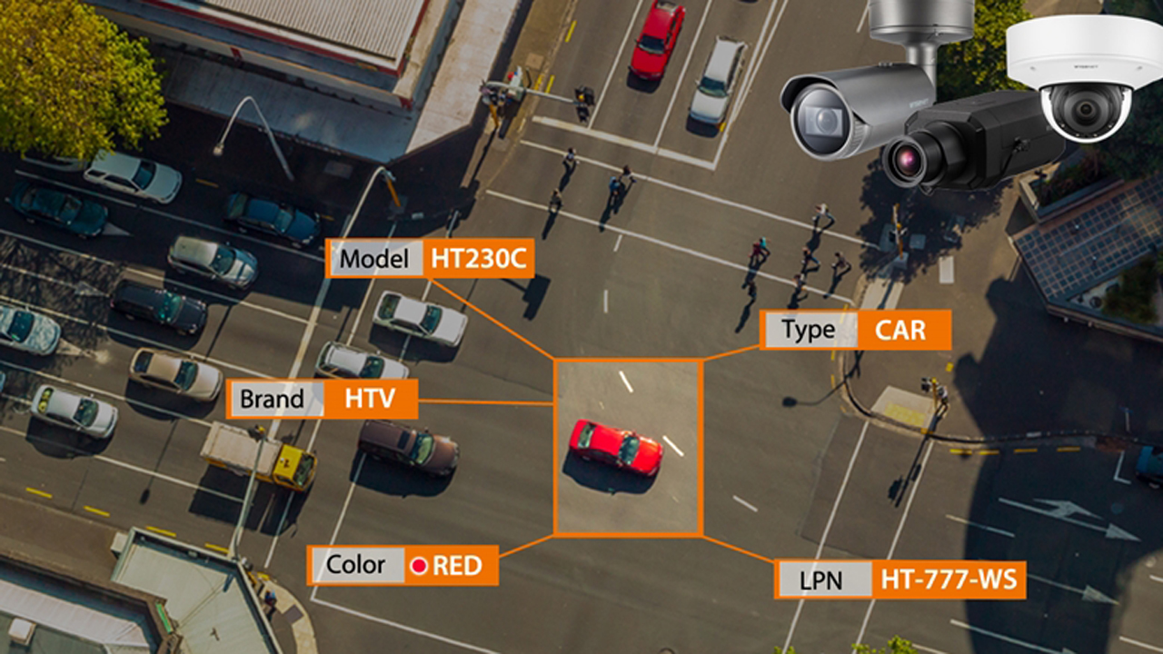
Car Document Validation through Automated Number Plate Monitoring using Yolo

Slide 2
What is ANPR?
ANPR (Automatic Number Plate Recognition) is a technology that automatically reads and analyzes vehicle license plates using cameras and image processing software. It identifies the license plate number and can compare it against databases for law enforcement, traffic management, parking systems, and toll collection. Privacy concerns arise due to the automatic collection of vehicle information.

Slide 3
flowchart
Capture Image
Color to Gray Conversion
Image filtering
Plate region extraction using algorithms
Segmentation
Region of interest extraction
Character recognition using OCR
Output

Slide 4
Where it is used?
This system helps in the function like detection of the number plates of the vehicle, process them and using processed data for further process
Usage of Car Number Plate detection (ANPR) can be use in car parking system
the most predominant usage of ANPR is Electronic Toll Collection system(ETC)
It can also be used for checking car document validation

Slide 5
Benefits of automated car document validation
Reduced human error
Eliminating the potential for manual errors and oversights, means a higher degree of accuracy in validation.
Efficiency & time savings
ANPR technology allows for almost instantaneous validation, enabling the rapid and high-volume processing of vehicles.
Cost reduction
Preventing fraud from falsified documents reduces liability, associated costs, and ensures greater compliance.
By automating the car document validation process through ANPR, we benefit from increased accuracy, time savings, and reduction in fraud and associated costs.

Slide 6
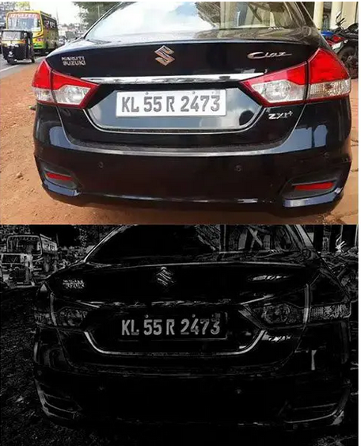
Processing of the image
Graying of Original Image
As the problem lies with the data size of the original plate image is the larger one the calculated amount of direct processing these colours is extremely large, so transform the original image into 256 level gray image convenient for the computer processing gray-scale image only have brightness information instead of colour information .

Slide 7
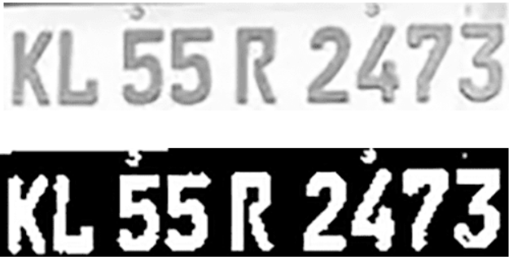
Plate region extraction using algorithms
The ROI pre-thresholding and border cleanup

Slide 8
Character recognition using OCR
kl55r2473

Slide 9
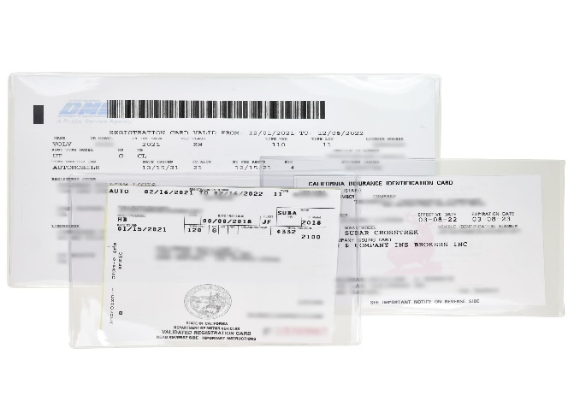

Validation of Car Documents
Documents to Validate
How ANPR helps with document validation
Registration papers, insurance certificates, driver's licenses. These can be easily falsified, leading to dangerous and costly situations.
ANPR technology can cross-check the number plate against the registration and insurance records to ensure the documents are genuine.

